Slide 1
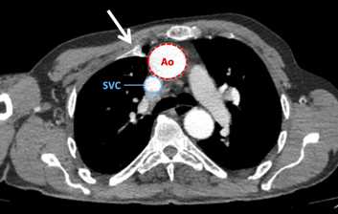
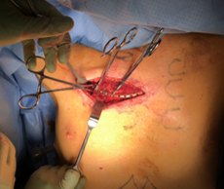
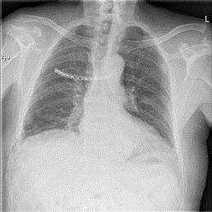
Video-Assisted Thoracoscopic Surgical Rib Fixation for Costochondral Separation Injury
CASE REPORT
75-year-old male with costochondral separation and mediastinal compression
INTERVENTION
Video-assisted thoracoscopic surgical rib fixation
OUTCOME
Successful repair and no complaints at 3-month follow-up
Geraedts et al. Innovations. November/December 2021.
@Innovationsjour | Copyright © The Author(s) 2021. All rights reserved. Published by SAGE Publishing Inc.

