Slide 1
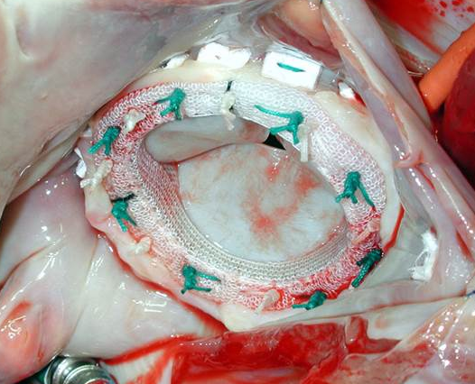
Contemporary Reoperative Mitral Valve Surgery: Technical Considerations and Clinical Outcomes
REVIEW POPULATION
Reoperative mitral valve surgery has become more common
Review topics include:
surgical approaches,
intraoperative strategies,
novel catheter-directed devices, and clinical outcomes
INTERVENTION
Minimally invasive techniques, better cardioprotective strategies and advanced perioperative care have improved outcomes
CONCLUSIONS
Although reoperative mitral valve procedures are technically-challenging and high-risk, outcomes continue to improve
Fatehi Hassanabad et al. Innovations. September/October 2020.
@Innovationsjour | Copyright © The Author(s) 2020. All rights reserved. Published by SAGE Publishing Inc.

