Slide 1
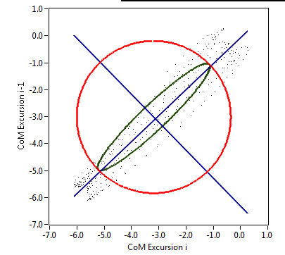
Figure two.
The phase plots of gait analysis; indicating variability in step length (β), variability in both cadence as step length (SD_{A})as well as variability in cadence (SD_{B}).

