Slide 1
The Misunderstood Schema of the Strong Black Woman: Exploring Its Mental Health Consequences and Coping Responses Among African American Women
Kelly Yu-Hsin Liao, Meifen Wei, and Mengxi Yin
Teaching slides prepared by Charlotte Strauss Swanson

Slide 2
Study Abstract
The internalization of the Strong Black Woman (SBW) schema is associated with negative psychological outcomes. However, not much is known about the mechanisms through which this schema leads to poor health. We examined the direct associations between the SBW schema and depression, anxiety, and loneliness. We also tested four mediators—maladaptive perfectionism, self-compassion, and two Africultural coping strategies of collective coping and spiritual coping—between the schema and psychological outcomes. Moreover, we examined serial mediation effects. A total of 222 African American women participated in an online survey. Structural equation modeling was conducted, and after controlling for age, family income, and level of education, the direct associations were supported, and the mediator roles of maladaptive perfectionism, self-compassion, and collective coping but not spiritual coping were supported. For serial mediation effects, the SBW schema was first positively associated with maladaptive perfectionism, which was associated with low self-compassion and low use of collective coping, which in turn were correlated with negative psychological outcomes. Racial, economic, and structural inequalities that maintain the SBW schema need to be examined and removed. Clinical interventions should focus on reducing maladaptive perfectionism and increasing self-compassion and collective coping among those who have internalized the schema.

Slide 3
Discussion Questions

Slide 4
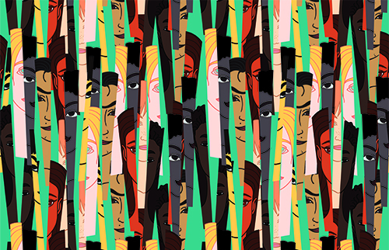
Intersectionality
In their paper, the authors refer to the concept of intersectionality. How do you understand this term and why is it important in the context of understanding the experiences of African American women?

Slide 5
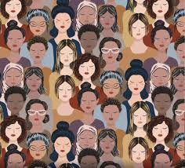
Gendered Racism
What is gendered racism?
What are the potential implications of gendered racism for black women, specifically in regard to mental health?

Slide 6
Strong Black Woman Schema
How do the authors define the Strong Black Woman (SBW) schema?
What are some of the possible benefits as well as negative consequences of this schema on mental health?

Slide 7
The Role of Socialization
The authors note that African American women often internalize the SBW schema as a result of messages perpetuated in the media, by parents, and in communities. Where have you seen this schema perpetuated? What are some examples?

Slide 8
Results
What were your reactions to the results in this study? Were you surprised by any of the findings?

Slide 9
Perfectionism & Self-Compassion
The researchers found that maladaptive perfectionism (MP) and self-compassion mediated the link between the SBW schema and anxiety and depression symptoms. How do you understand and/or explain this?

Slide 10
Africultural Coping Strategies
What did the results indicate about the role of collective and spiritual coping in the link between the SBW schema and depression/anxiety symptoms?
What about with loneliness?
Were there differences between these two types of coping and how might you explain them?

Slide 11
Practice Implications
What practice implications do the authors discuss, specifically for counselors working with African American women?
What are some of the implications regarding access to mental health care?
Are there other implications you can think of?

Slide 12
Societal-Level Change
What structural changes do the authors recommend to address the negative ramifications of the SBW schema (e.g, in schools, the media, and social policy efforts)?
What additional suggestions can you think of?

Slide 13
Strengths and Limitations
What do you believe are some strengths of this study?
What are some limitations?

Slide 14
What Next?
After reading this article, what research would you like to see done next?

Slide 15
Final Thoughts?
Did anything else come up for you in reading this article that we didn't discuss?

