Slide 1
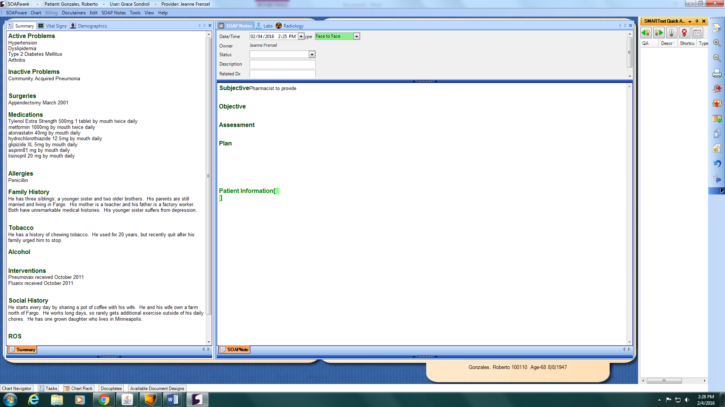
Active Problems
Hypertension
Dyslipidemia
Type 2 Diabetes Mellitus
Arthritis
Inactive Problems
Community Acquired Pneumonia
Surgeries
Appendectomy March 2003
Medications
Tylenol Extra Strength 500mg 1 tablet by mouth twice daily
Metformin 1000mg by mouth twice daily
Atorvastatin 40mg by mouth twice daily
Hydrochlorothiazide 12.5mg by mouth daily
Glipizide XL 5mg by mouth daily
Aspirin 81mg by mouth daily
Lisinopril 20mg by mouth daily
Allergies
Penicillin
Family History
He has three siblings; a younger sister and two older brothers. His parents are still married and living in Green Lake. His mother is a teacher and his father a factory worker. Both have unremarkable medical histories. His younger sister suffers from depression
Tobacco
He has a history of chewing tobacco. He used for 20 years, but recent quit after his family urged him to stop.
Alcohol
Interventions
Pneumovax received October 2013
Fluarix received October 2013
Shingrex received January 2018 & August 2018
Social History
He starts every day by sharing a pot of coffee with his wife. He and his wife own a farm north of Brookfield. He works long days, so rarely gets additional exercise outside of his daily chores. He has one grown daughter who lives in Minneapolis.
ROS
08/16/18 9:25 AM
NOTE: Pharmacist to provide diabetic case review
OBJECTIVE:
Test or exam | Date of last exam | Result | Next due date
Monofilament test | 02/07/2016 | Normal
Dilated eye exam | 09/02/2018 | Normal
Fasting lipid panel | 02/07/2018 | LDL 86 mg/dL HDL 50 mg/dL TG 100 mg/dL Total 128 mg/dL
A1c | 11/10/2018 | 6.8%
Urine albumin | 03/16/2018 | Normal
Serum potassium | 06/10/2018 | 4.2 mEq/L
Serum creatinine | 04/09/2018 | 1.1 mg/dL
ASSESSMENT:
Patient has the following goals:
Test or exam | Goals
Hemoglobin A1c
Blood pressure
Pre-prandial blood glucose
Postprandial blood glucose
Pneumovax received October 2012
Fluarix received October 2012
The patient is eligible for the following immunizations:
Gonzales, Roberto 100110 Age 68 (8/8/1949)

Slide 2
Place the pictures in numerical order to learn the next task

Slide 3
Active Problems
Hypertension
Dyslipidemia
Type 2 Diabetes Mellitus
Arthritis
Inactive Problems
Community Acquired Pneumonia
Surgeries
Appendectomy March 2003
Medications
Tylenol Extra Strength 500mg 1 tablet by mouth twice daily
Metformin 1000mg by mouth twice daily
Atorvastatin 40mg by mouth twice daily
Hydrochlorothiazide 12.5mg by mouth daily
Glipizide XL 5mg by mouth daily
Aspirin 81mg by mouth daily
Lisinopril 20mg by mouth daily
Allergies
Penicillin
Family History
He has three siblings; a younger sister and two older brothers. His parents are still married and living in Green Lake. His mother is a teacher and his father a factory worker. Both have unremarkable medical histories. His younger sister suffers from depression
Tobacco
He has a history of chewing tobacco. He used for 20 years, but recent quit after his family urged him to stop.
Alcohol
Interventions
Pneumovax received October 2013
Fluarix received October 2013
Shingrex received January 2018 & August 2018
Social History
He starts every day by sharing a pot of coffee with his wife. He and his wife own a farm north of Brookfield. He works long days, so rarely gets additional exercise outside of his daily chores. He has one grown daughter who lives in Minneapolis.
ROS
08/16/18 9:25 AM
NOTE: Pharmacist to provide diabetic case review
OBJECTIVE:
Facilitator KEY
Test or exam | Date of last exam | Result | Next due date
Monofilament test | 02/07/2016 | Normal | Yearly, due today 1/31/19
Dilated eye exam | 09/02/2018 | Normal | Yearly, due 9/2/19
Fasting lipid panel | 02/07/2018 | LDL 86 mg/dL HDL 50 mg/dL TG 100 mg/dL Total 128 mg/dL | Yearly, due 2/7/19
A1c | 11/10/2018 | 6.8% | Biannual, due 6/10/19
Urine albumin | 03/16/2018 | Normal | Yearly, due 3/16/19
Serum potassium | 06/10/2018 | 4.2 mEq/L | Yearly, due 5/10/19
Serum creatinine | 04/09/2018 | 1.1 mg/dL | Yearly, due 4/9/19
ASSESSMENT:
Patient has the following goals:
Test or exam | Goals
Hemoglobin A1c | < 7.0%
Blood pressure | < 140/90 mmHg
Pre-prandial blood glucose | 80-130 mg/dL
Postprandial blood glucose | < 180 mg/dL
Pneumovax received October 2012
Fluarix received October 2012
Patient is eligible for the following immunizations: Prevnar, Pnemovax, Influenza
Gonzales, Roberto 100110 Age 68 (8/8/1949)

