Slide 1
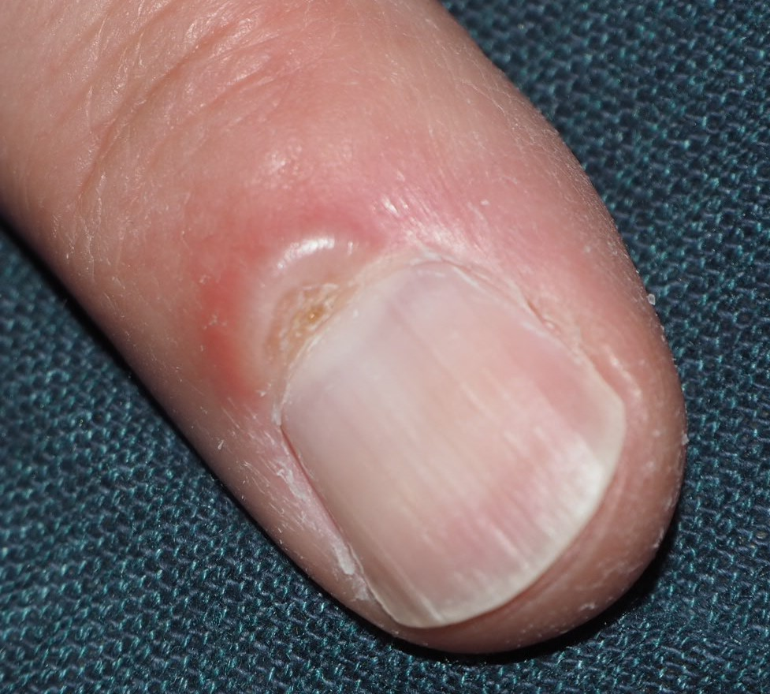
Swelling and chronic secretion eponychial fold, slight central nail deformity,
Radiographs unspectacular
US with hypochenogenic changes 2x1 mm, no hypervascularity DD foreign body, granuloma
Surgery revealed a wood splinter 2x1mm

Slide 2
6 weeks later blister-like appearance and swelling more proximal
Puncture revealed a ganglion cyst
More proximal

