Slide 1
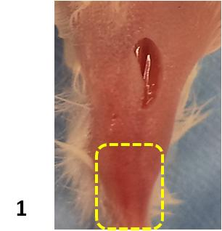
Figure 1. Exemplary picture of the incision area in the right inguinal region of the operated mice. Gastrocnemius muscle is outlined in yellow.

Slide 2
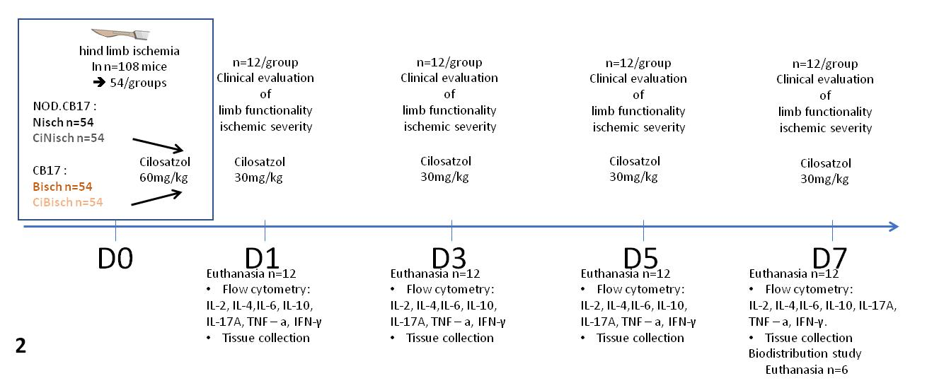
Figure 2. Schematic illustration of experimental protocol.

Slide 3
Table 1. Effect size and p-values of cytokine analysis
 | D1 |  | D3 |  | D5 |  | D7
NOD CB17 | P Value | R² | P Value | R² | P Value | R² | P Value | R²
TNF | < 0.0001 |  | 0.5792 |  | < 0.0001 |  | 0.5223 | 0.02117
IFN | < 0.0001 | 0.9164 | 0.0174 | 0.3283 | < 0.0001 | 0.8604 | 0.3526 | 0.04227
IL-6 | < 0.0001 | 0.8778 | 0.0079 |  | < 0.0001 |  | 0.6599
IL-4 | 0.9219 | 0.000485 | 0.0018 | 0.3682 | 0.3259 |  | 0.2258 | 0.08099
IL-10 | 0.4436 | 0.02939 | 0.9566 | 0.000207 | 0.0918 | 0.127 | 0.4238 | 0.04014
IL-2 | 0.9365 | 0.000295 | 0.0376 | 0.182 | 0.0177 | 0.23 | 0.0116 | 0.2564
CB17 | P Value | R² | P Value | R² | P Value | R² | P Value | R²
TNF | 0.053 | 0.1674 | 0.8998 | 0.00075 | < 0.0001 |  | < 0.0001
IFN | 0.0002 |  | 0.0197 | 0.2333 | < 0.0001 | 0.9112 | 0.0008
IL-6 | 0.0001 |  | 0.0035 | 0.4811 | 0.0003 | 0.478 | < 0.0001
IL-4 | < 0.0001 | 0.7119 | 0.0126 | 0.2522 | 0.171 | 0.1561 | 0.0428
IL-10 | < 0.0001 |  | < 0.0001 |  | < 0.0001 |  | < 0.0001
IL-2 | < 0.0001 | 0.7333 | < 0.0001 |  | < 0.0001 |  | < 0.0001 | 0.843

Slide 4
Table 2. Effect size and p-values of immunohistochemistry analysis
 | D1 |  | D3 |  | D5 |  | D7
NOD CB17 | P Value | R² | P Value | R² | P Value | R² | P Value | R²
Mac-3 | 0.002507 | 0.4561 | 0.207723 | 0.389 | 0.144045 |  | < 0.0001
cd31 | 0.0008 | 0.442 | 0.0754 |  | < 0.0001 | 0.8125 | < 0.0001 | 0.7106
H&E | 0.106153 | 0.3481 | 0.012845 | 0.5812 | 0.633323 | 0.1094 | < 0.0001 | 0.8512
CB17 | P Value | R² | P Value | R² | P Value | R² | P Value | R²
Mac-3 | 0.311796 | 0.2476 | 0.123325 | 0.3286 | 0.109734 |  | < 0.0001 | 0.7498
cd31 | 0.0071 | 0.2993 | 0.743 |  | 0.0815 | 0.1331 | 0.0038 | 0.3625
H&E | 0.2993 | 0.4892 | 0.237032 |  | 0.736874 | 0.1275 | 0.816298 | 0.1401

Slide 5
Table 3. Effect size and p-values of biodistribution study
 | NOD CB17 |  | CB17
 | P Value | R² | P Value | R²
blood | 0.7455 | 0.0110 | 0.3917 | 0.0742
heart | 0.8242 | 0.0052 | 0.4843 | 0.1399
liver | 0.7381 |  | 0.5714
spleen | 0.3499 | 0.0877 | 0.0056 | 0.1898
lung | 0.1881 | 0.1664 | 0.6283 | 0.1769
kidney | 0.3051 | 0.1046 | 0.4018 | 0.0712
stomach | 0.3763 | 0.0790 | 0.5584
intestine | 0.3825 | 0.0770 | 0.6497 | 0.0215
LH | 0.0063 | 0.5425 | 0.0711 | 0.4783
Operated | 0.0147 | 0.4643 | 0.4411 | 0.0605

