Slide 1
Why Women Are Blamed for Being Sexually Harassed: The Effects of Empathy for Female Victims and Male Perpetrators
Renata Bongiorno, Chloe Langbroek, Paul G. Bain, Michelle Ting, and Michelle K. Ryan
Teaching slides prepared by Charlotte Strauss Swanson

Slide 2
Study Abstract
The #MeToo movement has highlighted the widespread problem of men’s sexual harassment of women. Women are typically reluctant to make a sexual-harassment complaint and often encounter victim-blaming attitudes when they do, especially from men. Informed by the social identity perspective, two experiments examined the influence of empathy—both for women who are sexually harassed and for male harassers—on men’s and women’s propensity to blame victims. In Study 1, university students (N = 97) responded to a vignette describing a male student’s harassment of a female student. Men blamed the victim more than women, which was explained by their greater empathy for the male perpetrator but not lesser empathy for the female victim. Using the same vignette, Study 2 asked university students (N = 135) to take either the male perpetrator’s or the female victim’s perspective. Regardless of participant gender, participants who took the male-perpetrator’s perspective versus the female-victim’s perspective reported greater victim blame, and this was explained by their greater empathy for the male perpetrator and lesser empathy for the female victim. Together, the findings provide evidence to suggest that male perpetrator empathy may be equally or more important than female-victim empathy for explaining victim blame for sexual harassment. Implications for social-change, including policies to limit male-perpetrator empathy when processing women’s sexual-harassment complaints in organizational settings, are discussed.

Slide 3
Discussion Questions

Slide 4
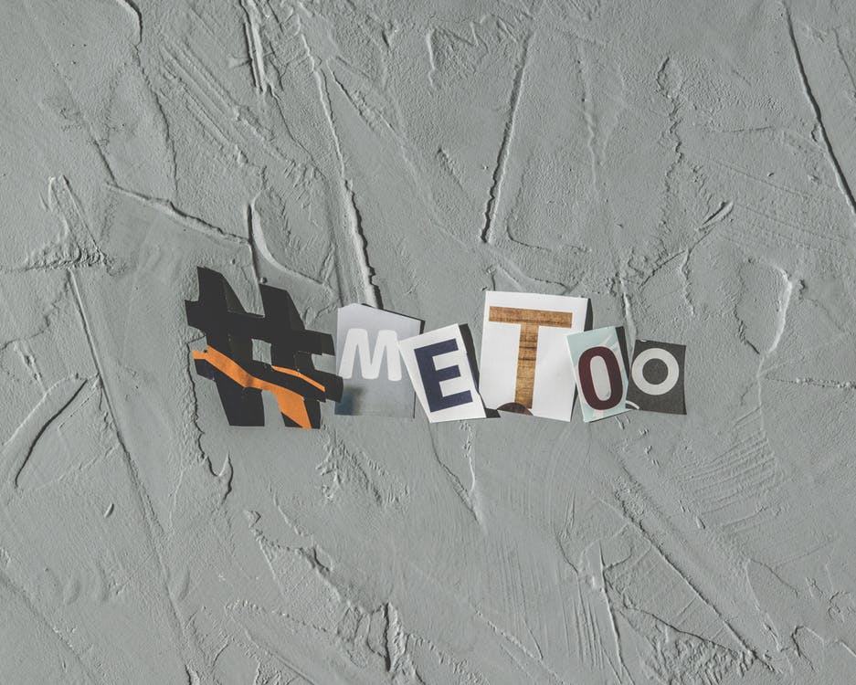
#MeToo and Spreading Awareness
In what ways do you think the national dialogue about sexual harassment has changed as a result of the #MeToo movement?

Slide 5
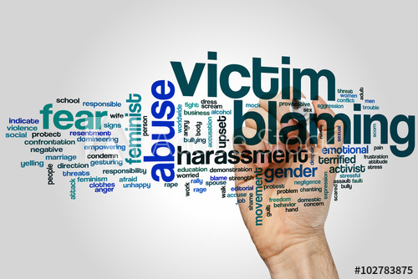
Victim Blaming
What factors do you think contribute to victim blaming attitudes (i.e., attitudes that victims are responsible for the sexual harassment they experienced)?

Slide 6
Social Identity Theory
What is the social identity perspective and how does it inform the authors’ hypotheses?

Slide 7
Empathy
What role do you think empathy plays in people’s negative attitudes to female victims of sexual harassment?

Slide 8
Results
What were your reactions to the results in this study? Were you surprised by any of the findings?

Slide 9
Implications
What are some of the implications of the results of this article? How might empathy for male perpetrators impact how men engage in violence prevention efforts? Or their support for victims?

Slide 10
Mass Media
In what ways do you think the mass media plays a role in how the public empathizes with either male perpetrators or female victims?

Slide 11
Practice Implications
What are some of the practice implications the authors mention? Can you think of any others? How might the results inform efforts to prevent sexual violence?

Slide 12
Social-Change Campaigns
What suggestions do the authors make about how the results of the study can inform social-change campaigns? If you were designing a social-change campaign, what information would you choose to include and why?

Slide 13
Strengths and Limitations
What do you believe are some strengths of this study?
What are some limitations?

Slide 14
What Next?
After reading this article, what research would you like to see done next?

Slide 15
Final Thoughts?
Did anything else come up for you in reading this article that we didn't discuss?

